Slide 1
Guide for test takers
IELTS Life Skills is for people who need to prove their English speaking and listening skills at Common European Framework of Reference for Languages (CEFR) Levels A1, A2 or B1.
Before you register for your test you should visit www.gov.uk to check the English language requirements for your visa category.

Slide 2
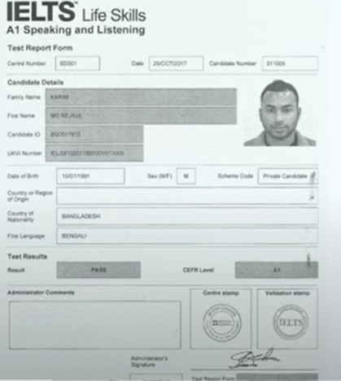

Slide 3
What’s in the test?
IELTS Life Skills is available at three levels:
IELTS Life Skills – A1 Speaking and Listening
IELTS Life Skills – A2 Speaking and Listening (offered in the UK only)*
IELTS Life Skills – B1 Speaking and Listening.
Results for IELTS Life Skills tests
Test results are normally available within seven days of your test.
You will get one of two results:
Pass
Fail

Slide 6
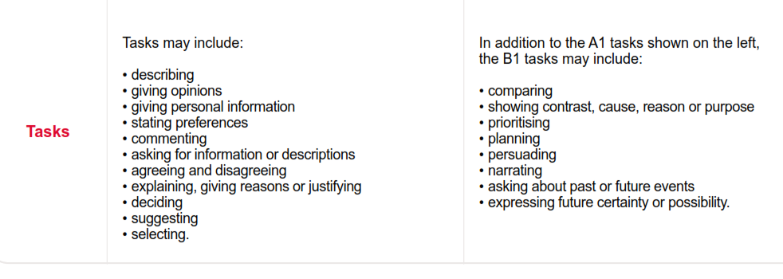

Slide 7
Prepare for your test A1
Phase 1 a
Phase 1 b
3. Phase 2 a
4. Phase 2 b

Slide 8
PHASE 1 A
4-5 minutes
The examiner will introduce him or herself and ask simple questions:
What is your name?
Can you spell your name, please?
Where are you from?
The examiner will ask questions about topics like: food, family, friends, free time activities
Pay attention to information questions
(when, where, how much, how far, how old, how many, why, which, when, what time,etc).
Make sure you understand the question, so listen carefully.
Answer the given question and speak clearly.
Relax and think the examiner is a family friend.

Slide 9
PHASE 1 B
5 minutes
The examiner give you and your partner two different topics.
You have to prepare questions to ask your partner about the given topic (you will have one and a half minutes to prepare your questions).
If you make a mistake while asking your question, ask that question again.
Use information questions instead of yes/no questions.
Try to keep eye contact while having a conversation with your partner.
While your partner is answering your questions, you can also say “that’s interesting”.
If you don’t understand your partner’s questions ask, please could you repeat that again?

Slide 10
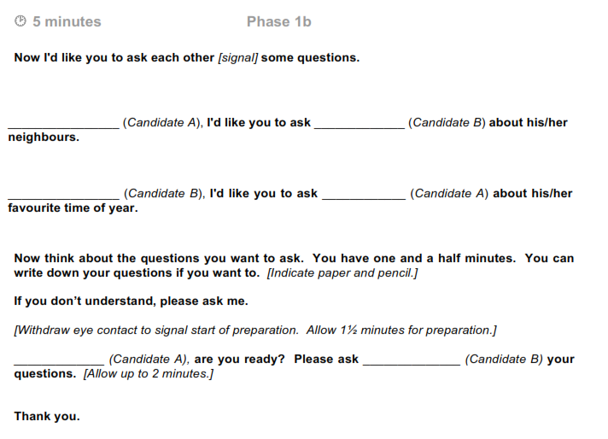

Slide 11
In this part of the test, you are going to listen to two recordings and answer some questions.
You can make notes [indicate paper] if you want to.
PHASE 2 A
4 minutes

Slide 14
You don’t need to answer using long sentences, it could be just a word or a few words.
Listen for the key information and important words.
You are allow to take notes (the examiner will provide a paper).
Make sure you understand times, places and dates. Pay attention to the nouns, verbs and adjectives.
Stay focused, don’t look at your partner or the examiner searching for extra information.
PHASE 2 A
4 minutes

Slide 15
Now you’re going to talk together about places you like to go to at the weekend. Talk to each other about places that you like to go to, and what you like to do there.
The theme of the topic could be related to what you listened in the previous section.
Usually the examiner will indicate the person who could start this activity. If you not, you can ask your partner: Shall I start? Do you want to start ?
Think this is a normal conversation.
Keep eye contact with your partner.
Listen to your partner and reply to what he or she say.
If your partner is speaking too much, you can also say: Excuse, can I say something about it?
If your partner is finding difficulties in answering and responding, try to help your partner by asking a simple question. It is important to keep the conversation going, but don’t change the topic.
PHASE 2 B
3 -4 minutes

Slide 16
Additional resources / grammar A1
Use My English Lab to practice
https://www.pearson.com/english/login-register/myenglishlab.html
Provide the user name and password given by your tutor.

