Slide 1

BUSINESS
ENGLISH

Slide 2

CROSS CULTURAL BUSINESS
Doing
business with Japan
Doing
business with US
2

Slide 3
Making business around the World
Every culture is different and has different styles of etiquette.
There are misunderstandings, even between similar cultures.
Remember that a poor first impression could leave your prospective partner or customer with a bad feeling.
Knowing the right etiquette can help you avoid this and save you a great deal.
UNIT 3_CROSS CULTURAL BUSINESS
3

Slide 4

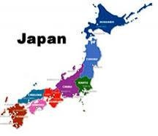
Etiquette Rules: Doing business with
Japan
Silence is Golden
In a business setting, silence is valued over an overabundance of talking.
Silence is linked to credibility, as
it speaks loudly about wisdom
and emotional self-control.
In times of stress during a meeting,
the Japanese will often resort to
silence in order to release the
tension in the room.
UNIT 3_CROSS CULTURAL BUSINESS
4

Slide 5

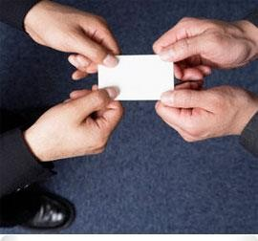
Etiquette Rules: Doing business with
Japan
Business Cards are important
For Japanese business professionals,
a business card is an extension of
their identity.
Accept the card with both hands,
briefly read it and place it in your
business card holder if you are
standing.
if you are seated, place it on the table
for the duration of the meeting and then
place it in your business card holder.
•
•
UNIT 3_CROSS CULTURAL BUSINESS
5

Slide 6

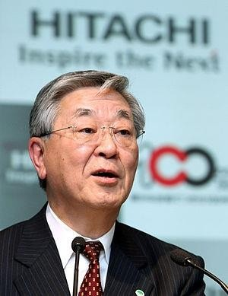
Etiquette Rules: Doing business with
Japan
Age equals Seniority
Treat older executives with a more
marked deference than you do
younger ones in the group
Be sure to greet the most senior person before you greet others.
Also offer your business
senior person first.
card to the
UNIT 3_CROSS CULTURAL BUSINESS
6

Slide 7
Etiquette Rules: Doing business with
Japan
Japan is a group orientated culture
Don't drive too hard on decisions and deadlines.
Japanese decision-making style is by consensus.
Try to speed up the process may appear to be disrespectful of their way of doing business.
UNIT 3_CROSS CULTURAL BUSINESS
7

Slide 8
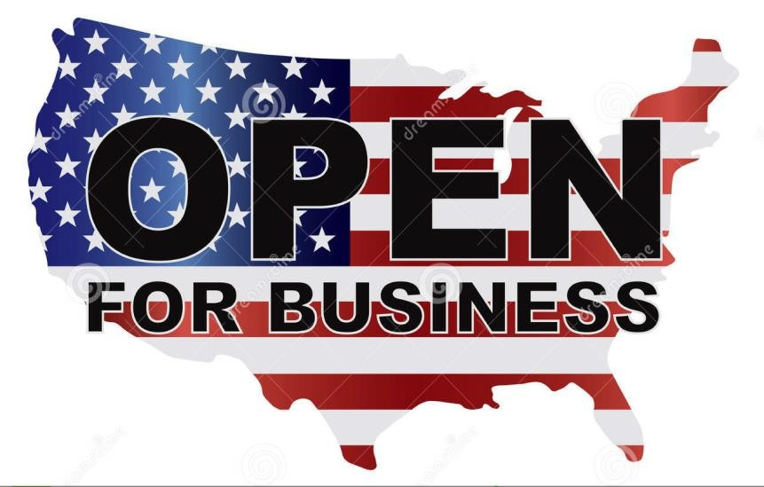
Etiquette Rules: Doing business with
USA
Individualism plays a key role in the US
US culture emphasizes individual initiative and personal achievement.
Independence and self-reliance are highly valued and also extends to the workplace where business is frequently carried out autonomously.
UNIT 3_CROSS CULTURAL BUSINESS
8

Slide 9
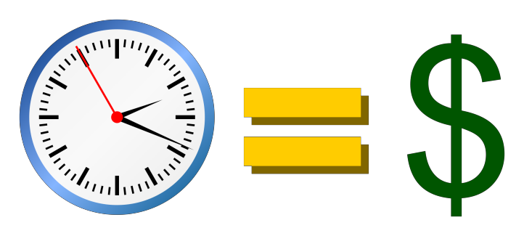
Etiquette
Rules:
Doing
business with US
Time is Money
Deadlines are strictly adhered to in
American business culture.
It is a great emphasis on getting the best results in the quickest time.
UNIT 3_CROSS CULTURAL BUSINESS
9

Slide 10
Etiquette Rules: Doing business with US
Small Talking
Be prepared to partake in preliminary small talk with your American counterparts at the beginning of a business meeting.
This could often include topics such as sport or the weather and is seen as a way to lessen apprehension and create a comfortable environment before entering into business affairs.
UNIT 3_CROSS CULTURAL BUSINESS
10

Slide 11
PRACTICE
Please watch the following video
https://www.youtube.com/watch?v=ZtUVmkbqcps
Think about ecuadorian business culture,
how we ecuadorians do business…
Do you find any similarities with the
Countries visited by Natasha? Why?
UNIT 3_CROSS CULTURAL BUSINESS
11

