Slide 1
TOP NOTCH FUNDAMENTALS

Slide 2
1. INTRODUCE YOURSELF 2. VERB BE 3. VOCABULARY: OCCUPATIONS 4. ARTICLES A /AN

Slide 3
INTRODUCE YOURSELF

Slide 4
HI
HELLO
GOOD AFTERNOON
GOOD MORNING
I AM (NAME)
I AM SANDRA
GOOD
EVENING
GOOD
NIGHT
NICE TO MEET YOU

Slide 5
FIRST TIME YOU MEET SOMEONE
TEACHER
HI. I AM SANDRA
STUDENT
HI SANDRA. I AM _______
TEACHER
NICE TO MEET YOU_________
STUDENT
NICE TO MEET YOU, TOO

Slide 6
SAY HELLO TO SOMEONE YOU ALREADY KNOW
PERSON 1
HI_____. HOW ARE YOU?
PERSON 2
FINE, THANKS. AND YOU?
PERSON 1
I AM FINE

Slide 7
SAYING GOOD BYE
PERSON 1
GOOD BYE______
GOOD BYE______
PERSON 2
PERSON 1
SEE YOU TOMORROW
SEE YOU LATER

Slide 8
Verb be

Slide 10
Name
Statements
SHE
She is Shakira.
Age
She is 42.
Occupation
She is a singer.

Slide 11
Name
Affirmative Contractions
SHE
She's Shakira
Age
She's 42
Occupation
She's a singer

Slide 12
Name
Negative sentences
SHE
She is not Britney
Age
She is not 20
Occupation
She is not a doctor

Slide 13
Name
Negative contractions
SHE
She´s not Britney
Age
She´s not 20
Occupation
She´s not a doctor

Slide 14
Name
Negative contractions
SHE
She isn’t Britney
Age
She isn’t 20
Occupation
She isn’t a doctor

Slide 15
Exercise
Write about yourself, your favorite artist or a family member.
Name
PHOTO
Age
Occupation

Slide 16
Vocabulary: Occupations

Slide 17
VOCABULARY
a teacher

Slide 18
VOCABULARY
a student

Slide 19
VOCABULARY
an architect

Slide 20
VOCABULARY
a musician

Slide 21
VOCABULARY
a singer

Slide 22
Article A/AN

Slide 23
a / an = 1
A teacher = 1 teacher

Slide 24
GRAMMAR
a teacher
a musician
a student
an architect
an artist
a singer

Slide 27
An hour
A university

Slide 28
Exercises
He is ____ athlete
a
an

Slide 29
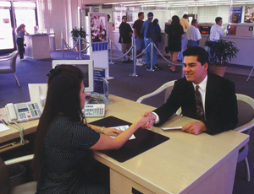
Exercises
She is ____ banker
a
an

Slide 30
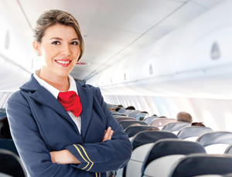
Exercises
She is ____ flight attendant
a
an

Slide 31
ONLINE LEARNING
www.travelandlearning.com.ec
didactica.online.edu@gmail.com

